Slide 1
Dog Gone
Authors: Andrew Doodson, Oscar Evans, Helen Morris, Torie Owers

Slide 2
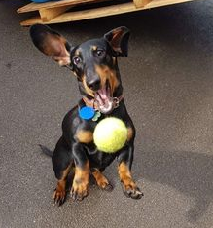
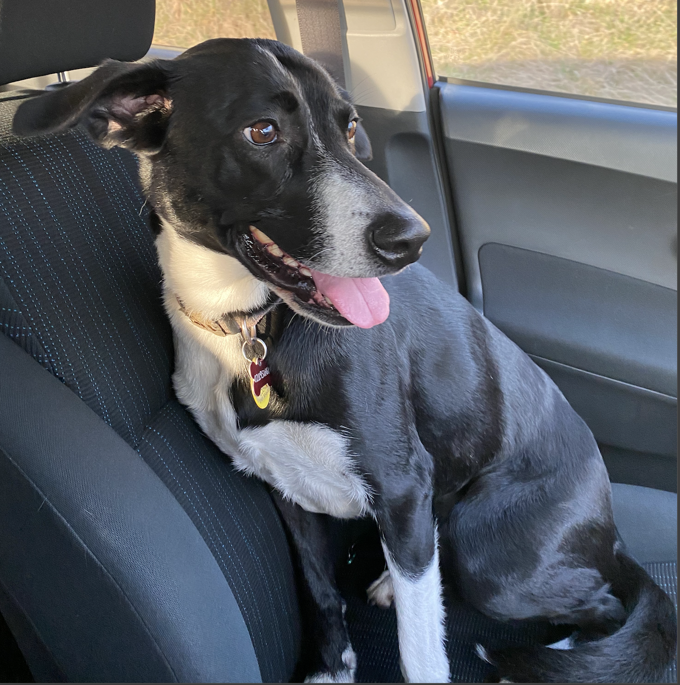
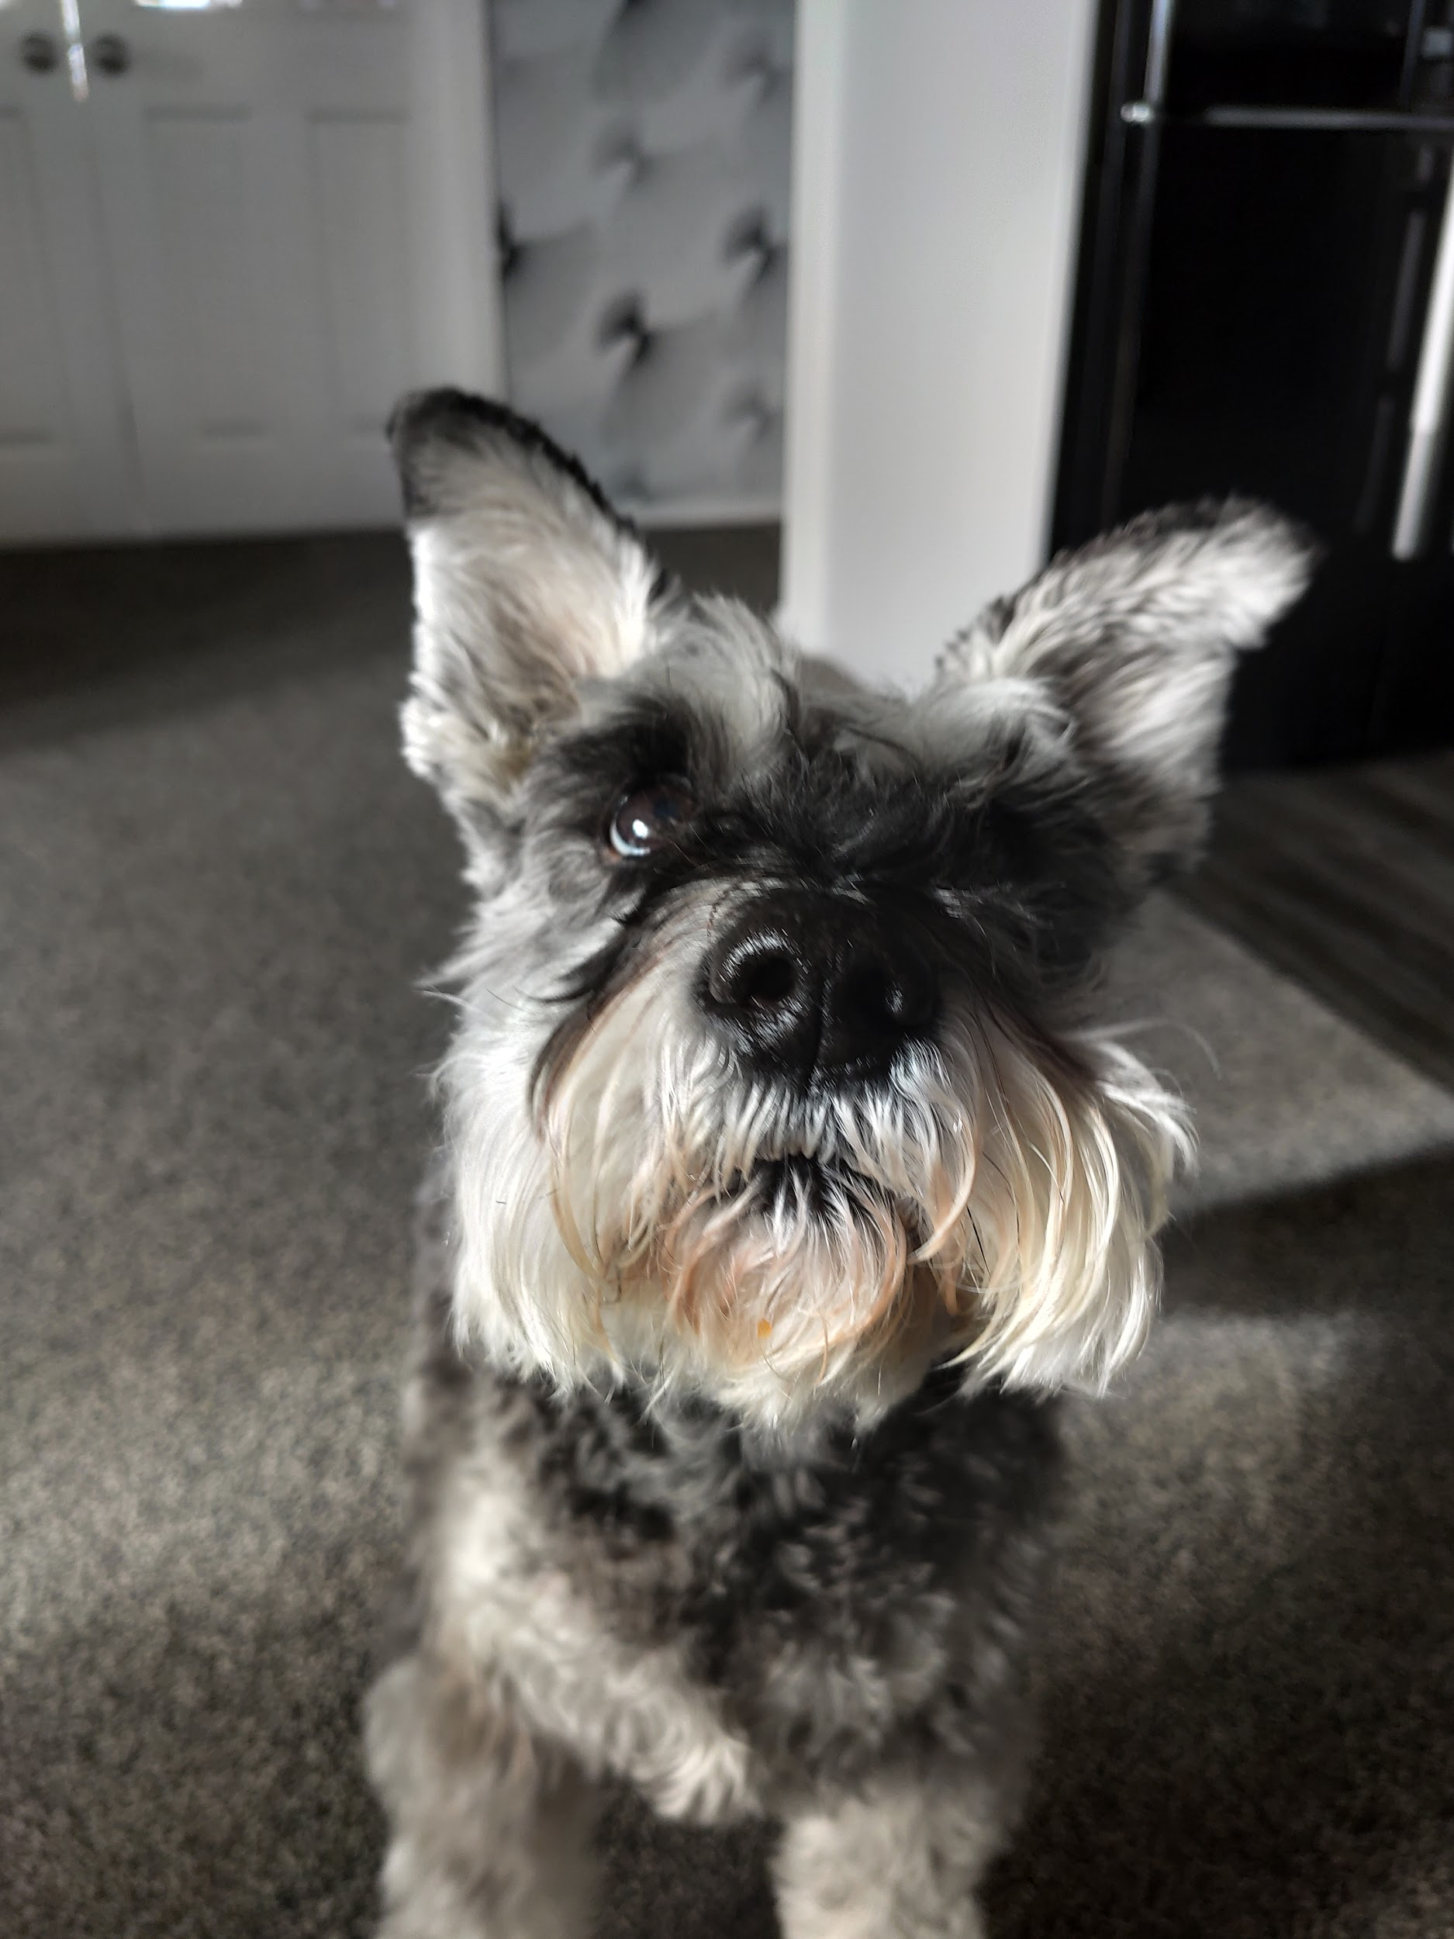
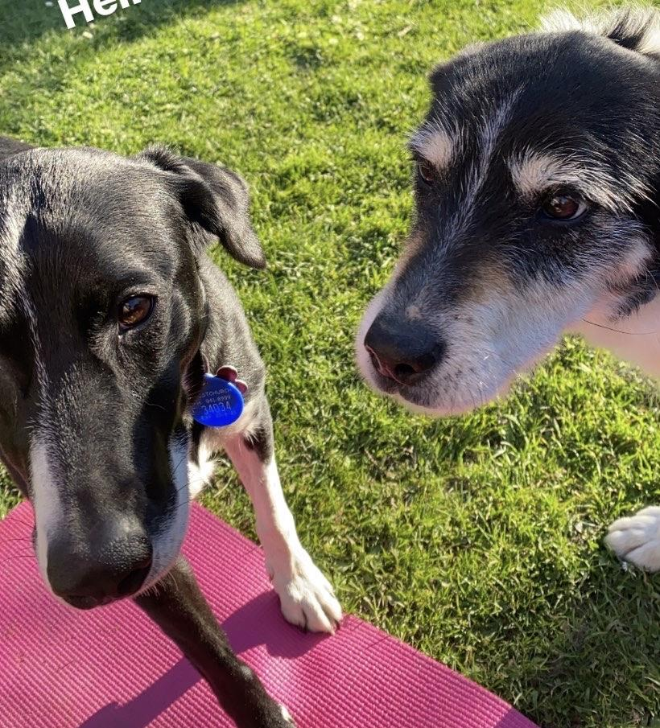
Dogs of our lives

Slide 3
Contents
An introduction to the project
The data sources and ethical considerations
How did we wrangle this data?
What does this data show?
A conclusion for the project

Slide 4
Data sources
Figure.nz Places
Demographic information for each district of NZ
Pets, Median Income, Housing
American Kennel Club
‘The Most Popular Dog Breeds of 2019’
Each breed has own descriptive page
Size, weight, temperament, etc.

Slide 5
Ethical Considerations
Whanaungatanga (Centrality of kinship)
Figure.nz was a tool purposed to inform the 2019 district elections
AKC looks to inform people to promote responsible dog ownership
Rangatiratanga (structure of authority)
Terms of use for each site allow scraping and promote data sharing
Manaakitanga (extending love, compassion and hospitality)
Data used to give back information to the people
Kotahitanga (Power held by the collective)
Benefit individually in project, collective benefits with findings shared freely
Kaitiakitanga (Acting as a guardian over precious things)
Care taken to ensure data was not improperly altered during wrangling
Notes:
In order to put into perspective the ethical considerations of this project, we decided to use the Maori view of the world discussed by Caleb Moses in his guest lecture. After consulting the terms of use and mission statement portions of each website, we came to the conclusion that the scraping, wrangling and distribution of findings derived from this data could be useful and interesting to the general population

Slide 6
Wrangling using R and Julia
^{Scraping in Julia}
^{American Kennel Club}
^{Wrangling CSVs from Figures.NZ}
Functions to read files and then get the information from each file
Notes:
From the AKC site scraped in Julia
Got the text for the breed as well as the link, then setup to go through the links and also scrape information on each page about the weight size and temperament on each page
Excess of unused information on each of the CSVs. Had to go through and extract what we wanted and put into dataframes.
We then had to use the information counts that we had to standardise the information to be by per capita. This makes comparison across regions fair.

Slide 7
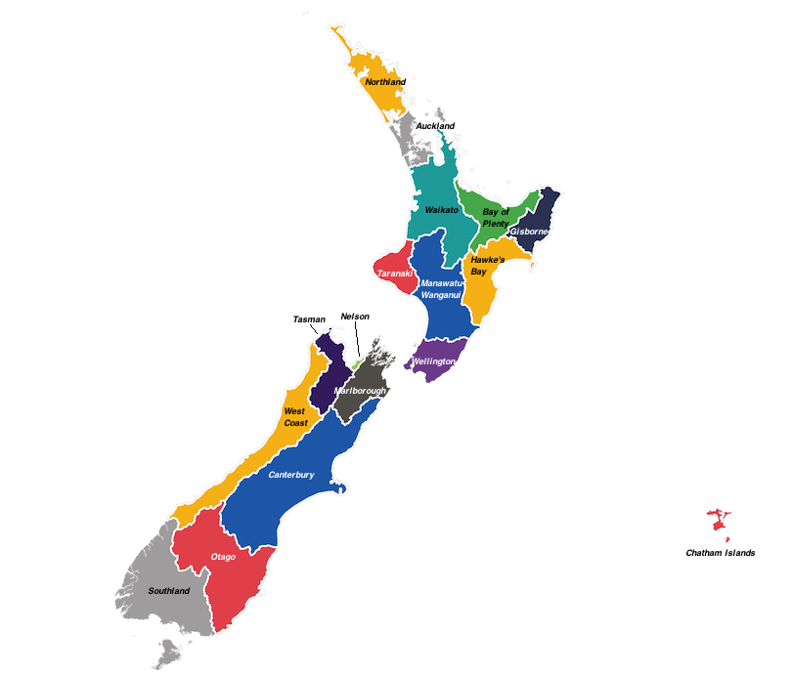

Slide 8
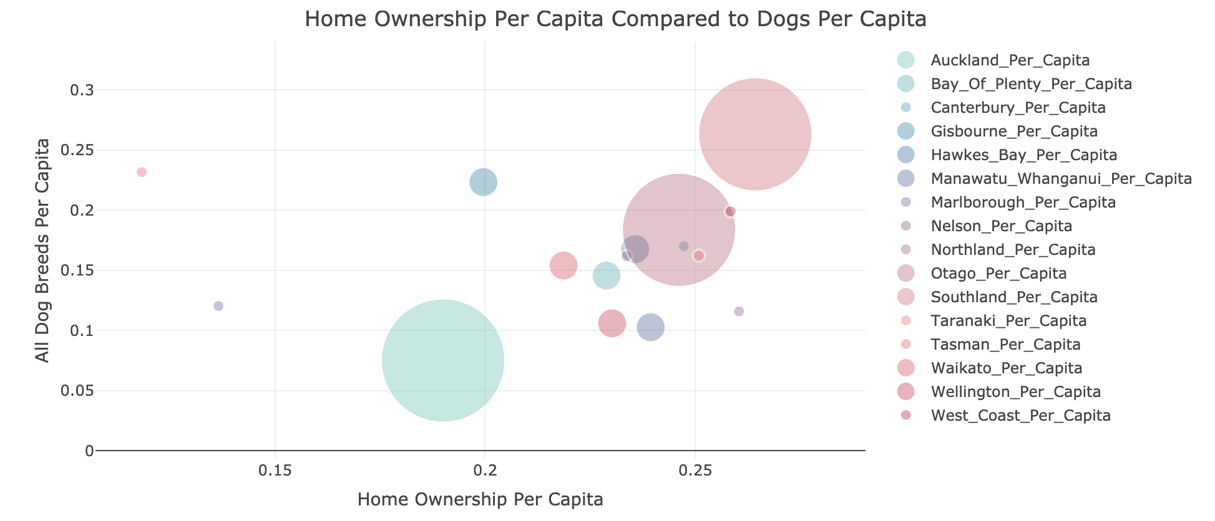
Data analysis: Home Ownership vs Dog per Capita
Cool Plot Here
Notes:
Plot shows the number of dogs per capita increases with an increase in home ownership in the region!

Slide 9
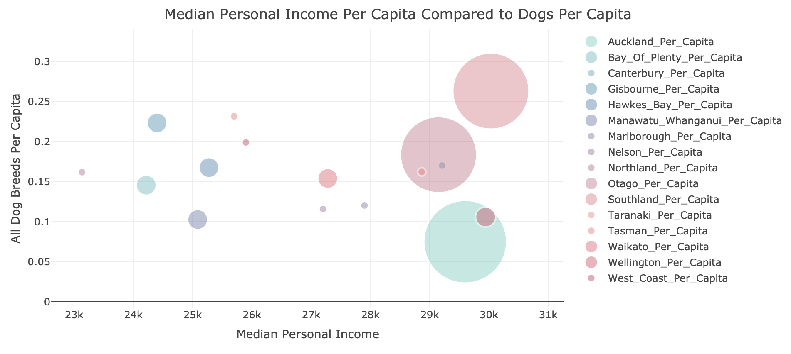
Data Analysis: Median Income vs. Dog Per Capita
Notes:
Shows regions with higher median income prefer bigger dogs!

Slide 10
Limitations
Missing data on a lot of popular breeds in New Zealand
Two specific NZ breeds (Heading and Huntaway) were not represented in the AKC dataframe.
A lot of mastiff breeds over-represented in figures - despite low or zero counts
Population data used to normalise per capita from 2013 vs Pet data from 2019
More specific breeds mentioned in the figures dataframe, eg. four types of collies (Smooth, Rough, Bearded and Border).
Notes:
missing information on registered dogs from our data source, many popular breeds were not included in the count – such as Dachsunds, Corgis, Great Danes. May not give full picture put gives general view of most popular breeds in NZ
A couple of NZ specific breeds were not a part of the AKC dataframe, the heading dog and huntaway. Heading dogs were initially bred from collies so decided to add to the collie set. Ended up removing Huntaway as they were not bred from a specific breed rather bred for specific characteristics ‘Loud bark’.
Mastiff breeds - menacing breeds, we believe this is why they were included in all the data despite representing almost none of the registered dogs. These were mostly filtered out.
The population data we used was from 2013 and was the data provided by figures
Able to join these breeds as the statistics we were looking at from AKC were the weight and temperament - all collies are similar weights and temperament

Slide 11
Conclusion
Labradors were the most popular dog in New Zealand
Home ownership could be a factor in dog ownership
Southland had the highest number of dogs per capita - 0.26, followed by Tasman with 0.23
Notes:
Goden retrievers and Labs were most popular

Slide 12

Future Work
Compare statistics of dog ownership in New Zealand to other countries
Aggregate more New Zealand specific breed information
Could look into companion animals registration in NZ
Compare ‘working’ breeds to proportion of registered breeds, e.g seeing eye dogs, police sniffer dogs
Notes:
Compare NZs favourite dog to other countries
Other dog information could be compared such as working breeds or companion animal information

